Slide 1
Testing React Components

Slide 2




What you will learn
Explain what is testing
List the advantages and disadvantages of testing
Describe the different approaches of component testing
Describe the testing tools

Slide 3

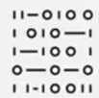
What is testing ?
Is a line-by-line review of how your code will execute
Can be a suite of tests comprising bits of code to verify error-free execution of application

Slide 4
Advantages and disadvantages of testing
Advantages
Prevents unexpected regression Allows focus on current task Allows modular construction of application
Reduces need for manual verification
Requires writing of more code, debugging, and maintaining
Causes integration rejection due to non- critical failures
Disadvantages

Slide 5

Why test React components?
Testing of React components:
Ensures application will work as intended
Verifies the code runs error-free
Tests functionality by replicating the actions of the end users
Validates any updates done do not affect the working of the overall application
Prevents regression that is reappearance of a previous fixed bug

Slide 6


Approaches of React component testing

Slide 7
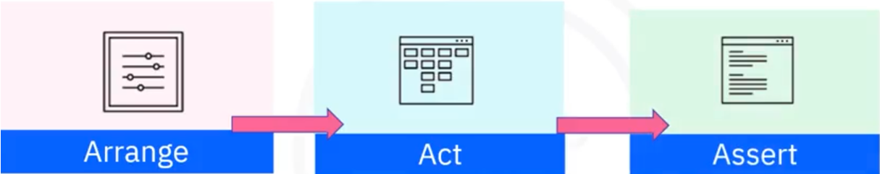
Phases of React component testing

Slide 8
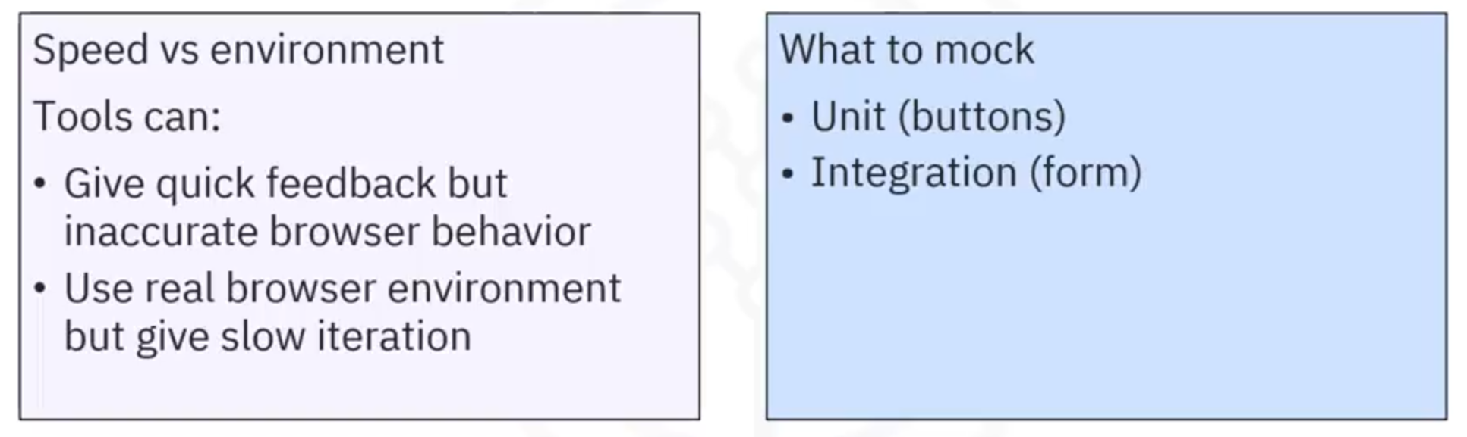
Choosing the right tool

Slide 9
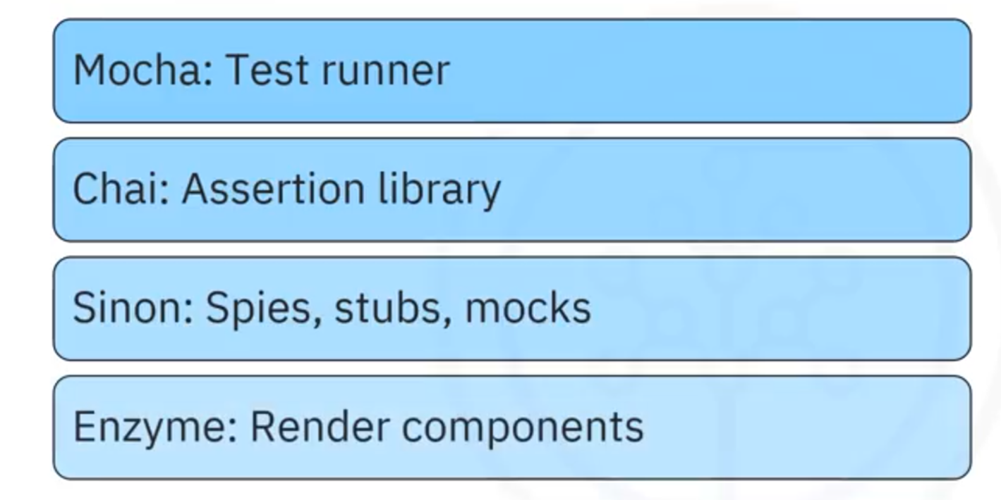
React testing libraries/tools

Slide 10
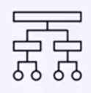

Popular React testing libraries
Jest
Combined Power of Mocha, Chai, Sinon
React Testing Library Set of helpers

Slide 11
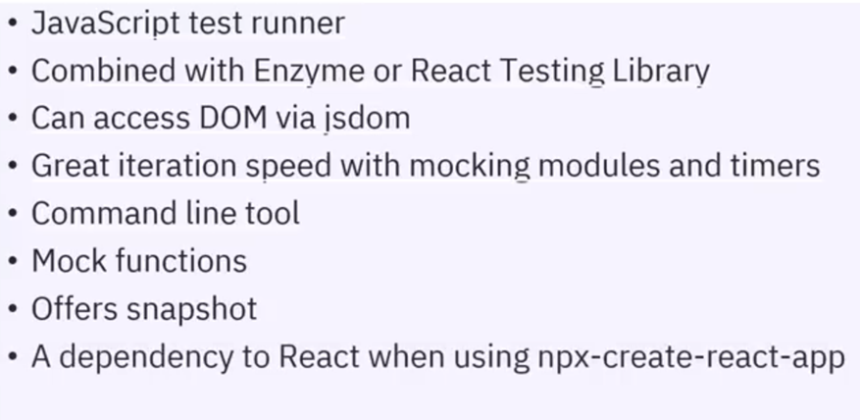
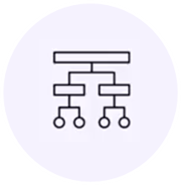
Testing with Jest

Slide 12
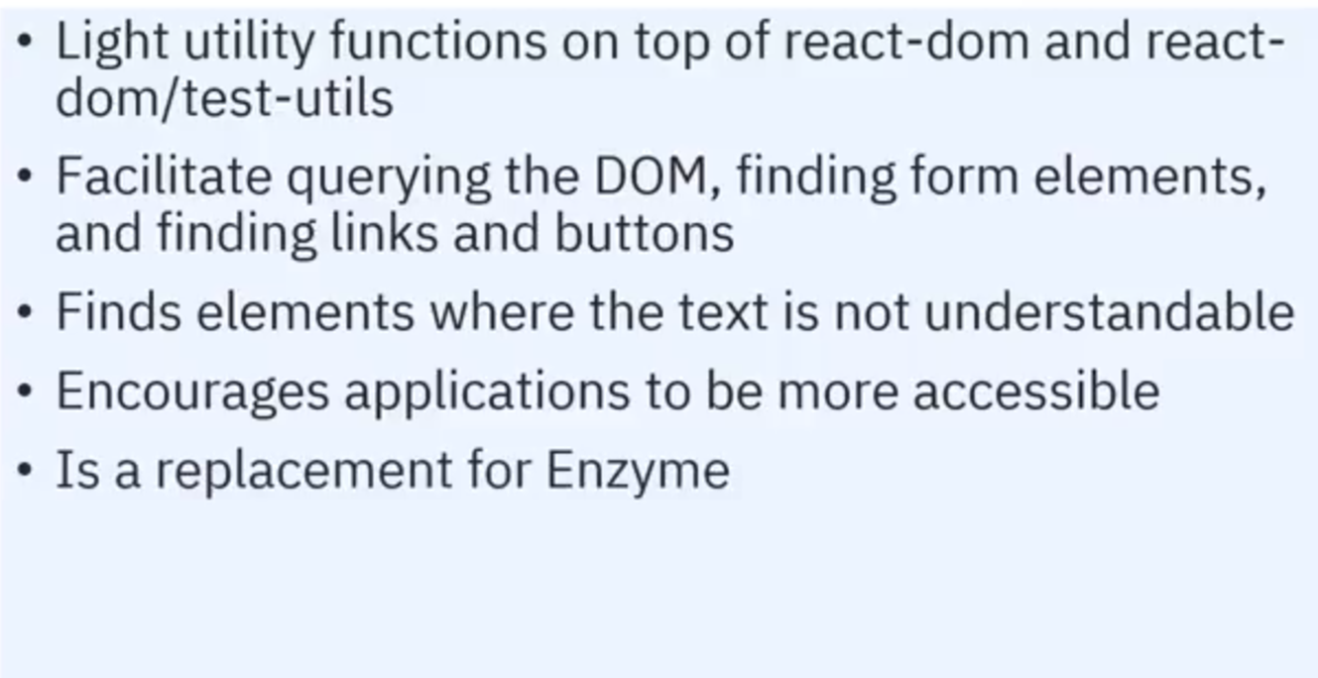

Testing with React Testing Library

Slide 13
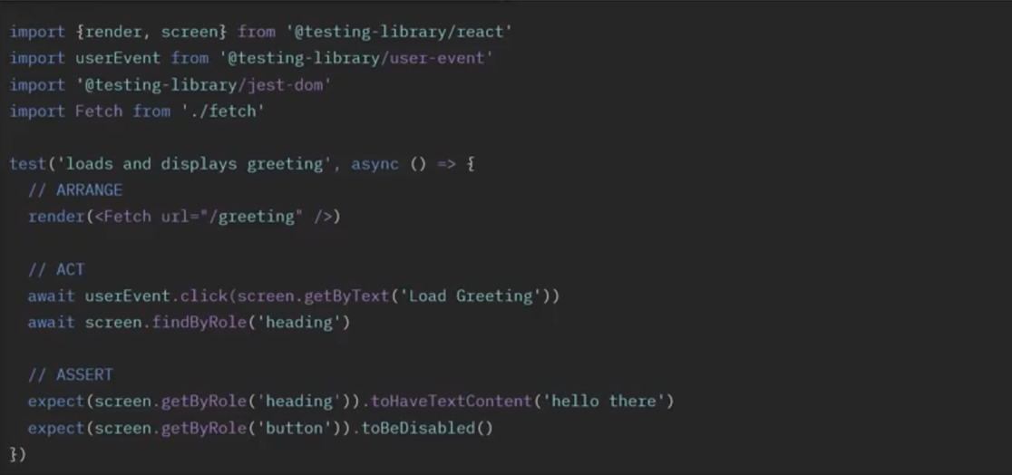
Example of usage of React Testing Libraries

Slide 14
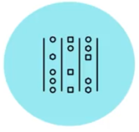
Benefits of React Test Library
Provides reliable testing of the components in the same way as an end user would use them
Enables you to write your tests based on the component output visible to the end users
Rewriting your tests increases your productivity

Slide 15
Recap
In this video, you learned that:
Testing is a line-by-line review of how your code will execute.
You can render component trees in a simple test environment or a realistic browser environment.
Component tests flow through three phases: Arrange, Act, and Assert.
React components can be tested using Mocha, Chai, Sinon, Jest and React Testing Library.
React Testing Library increases confidence in your tests by testing your components in the same way as an end user would use the components.

